Slide 1
Confidential Computing of Machine Learning using Intel SGX
Prasad Koshy Jose
Supervisor: Dr. Eduardo Solana
40 Slides ≈ 40 minutes

Slide 2

Abstract
Deploying applications on the cloud requires a certain trust on third party infrastructure providers, privileged softwares and other tenants utilizing the same platform. Unfortunately, this trust has been violated multiple times in the past. The training phase of machine learning methods requires large scale processing of sensitive data sets owned by enterprises and customers. Outsourcing the training process to a cloud-based service poses signiﬁcant security risks like breaches and compromised integrity of the data and the underlying model. An eﬀective way to overcome this security issue is to employ a machine learning system which uses a hardware-assisted Trusted Execution Environment (TEE), Intel SGX, to run the computations on sensitive data sets. The risks are potentially reduced by delegating most of the trust to the hardware. Multi-user data sets are securely sealed using AES-GCM, a cryptographic Authenticated Encryption (AE) method and is transmitted to the machine learning code residing in a secure enclave, insusceptible to any vulnerabilities of a traditional system. This architecture is signiﬁcantly secure with smaller attack surfaces and no signiﬁcant performance overhead. This work also emphasizes on responsible software design and development which is key for minimizing risks of system penetration and unauthorised access.

Slide 3
Abstract -Explained
Trust Third party infrastructure providers, privileged softwares and other tenants - Malicious or “Honest but Curious.
Sensitive & Confidential Data sets owned by enterprises and customers making Machine Learning borderline improbable.
Signiﬁcant security risks Competitive take-over, breach of individual privacy.
Intel SGX
Hardware-assisted Trusted Execution Environment (TEE) + Set of instructions for secure development.
Securely Sealed & Transmitted
AES-GCM Authenticated Encryption + Attestation.
Responsible software design
Application and enclave life cycles + Secure APIs + Practices.

Slide 4



Structure of the Paper & Presentation
Introduction
State of the Art
Security Framework of Intel SGX
Methods and Implementations
Security Considerations
Conclusion

Slide 5
The need for a secure computation platform.
Introduction
Risks of an untrusted execution environment How the data is stored and processed in a multi-tenant, 3rd party hardware providers.
Software development Securing legacy code, complex data and control flows.
Usage of Trusted 3rd party libraries
Attack Surfaces of the software system.
Data Security
Confidentiality + Integrity in storage and transit.
Facts:
- More than 10000 computer systems vulnerabilities are discovered each year
- A medium size software has around 50000 LOC.
Introduction

Slide 6
Solutions:
Homomorphic Encryption (FHE)
Trusted Execution Environments (TEE)
Drawbacks:
Large runtime overheads.
Limited computation
TEE
TPM
SGX
Introduction
Notes:
FHE - Arbitrary operations on encrypted data
Encryption involves the addition of small noise terms into cipher-texts(padding etc). This noise grows depending on the operation - Large for multiplications than additions.
Good performance for low-degree polynomials
TEE - can be implemented with TPMs and HSEs
Definitions of TEEs vary. Easier way to understand is TEEs are software based
TPM is a hardware based TEE.
Combining them is a good idea. Implemented by Intel SGX

Slide 7

2. State of the Art
Machine Learning and Neural Networks
Confidential and Oblivious Machine Learning
SGX Implementations
Attacks on TEE
Notes:
Icons made by <a href="https://www.flaticon.com/authors/freepik" title="Freepik">Freepik</a> from <a href="https://www.flaticon.com/" title="Flaticon"> www.flaticon.com</a>

Slide 8
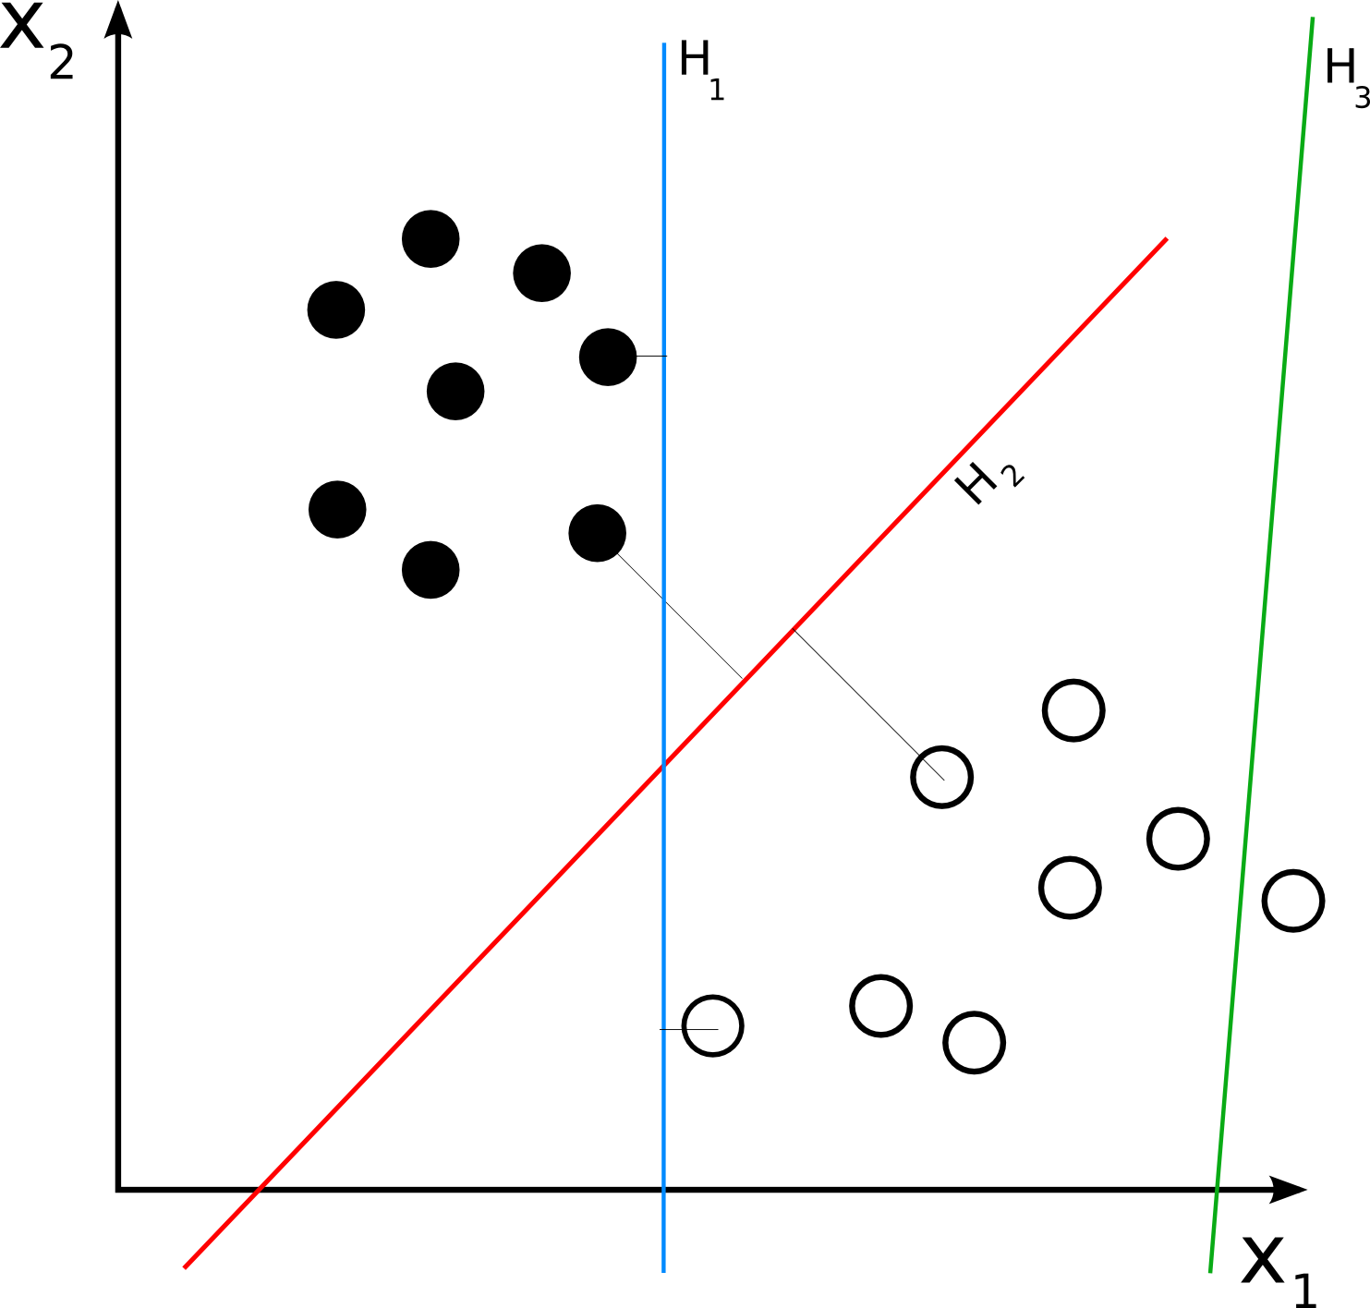
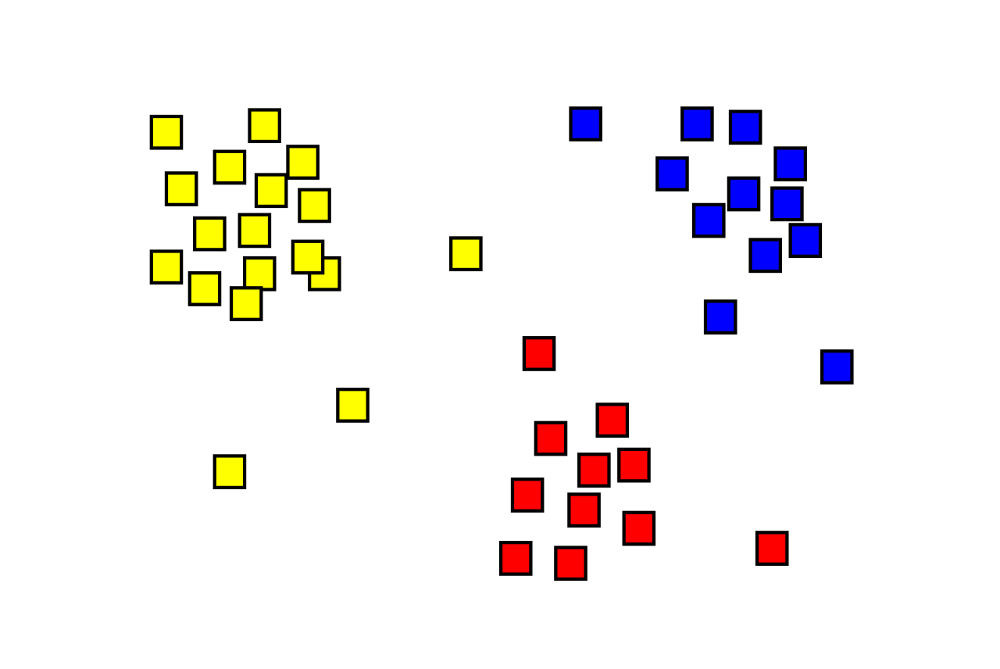
Machine Learning and Neural Networks
Machine learning is deﬁned as the ability of systems to learn from data.
Training is a continuous process, where the system updates its learning and improves its decision-making ability with more data.
In supervised learning, the system is given a historical data sample of inputs and known outputs, and it “learns” the relationship between the two using machine learning techniques.
Example - LDA
Unsupervised learning includes re-organizing and enhancing the input data to ﬁnd patterns in it and to place a structure on the unlabelled data
Example - -Cluster Analysis(KNN)
The most widespread application of machine learning is in data science and data science focuses on predicting(one outcome) or forecasting(multiple outcomes) the future trends.
2. State of the Art
Notes:
Supervised - Linear Discriminant Analysis (LDA) where the system is given a set of labelled data(like vector representations of digits along with the label).
Unsupervised - Here the system tries to ﬁnd a pattern among the individual data points and tries to cluster themwith respect to their similarities

Slide 9
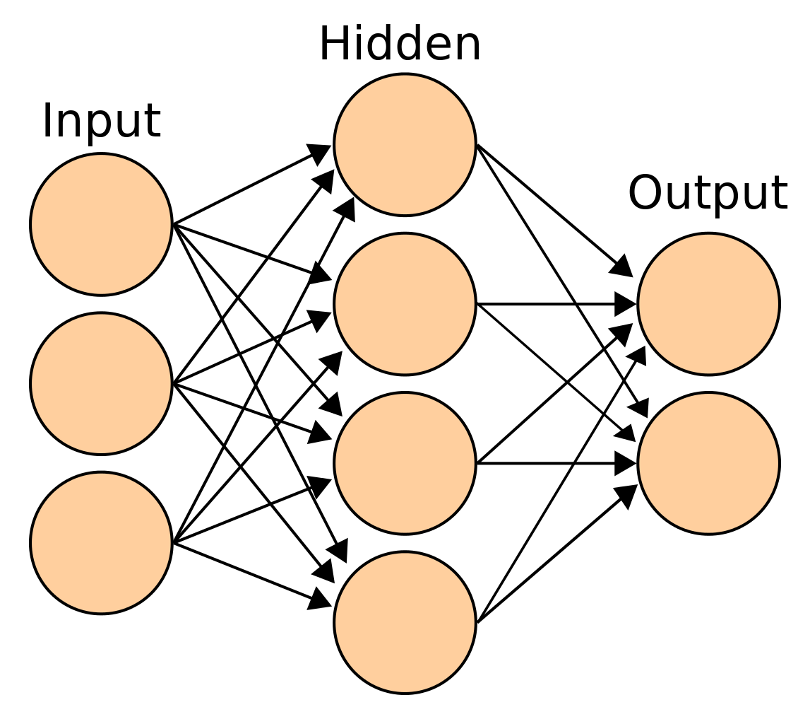
Machine Learning and Neural Networks
First idea of artiﬁcial neurons was presented in 1943 by neurophysiologist Warren McCulloch and mathematician Walter Pitts.
A neural network is an interconnected assembly of simple processing elements, units or nodes, whose functionality is loosely based on the animal neuron.
A system of nodes is called a Network.
The synapses are modelled by a single number or a weight so that each input is multiplied by a weight.
Feed-Forward pass Neural Network.
Back-Propagation : while training the network, we can
compare the output of the neural network to our expected
training value, y(z) and feasibly look at how changing the
weights of the output layer would change the cost function
for the sample.
CNNs & RNNs
2. State of the Art
Notes:
Weights - This is particularly useful if there is a need to model diﬀerent strengths of relationships among the input and output variables

Slide 10
Machine Learning and Neural Networks
How to implement Neural Network in a real life Use-case?
The input consists of an encoding of binary data(dark and light values) of an image of one alphabet.
The output layer has 26 nodes, one for each letter of the alphabet.
So when an input image is passed into the network,
one neuron is ﬁred whenever a pattern of the corresponding class is supplied at the input.

Slide 11
2. Confidential and Oblivious Machine Learning
Machine Learning(ML) - two stages: the training stage and the classiﬁcation stage. Either one or both of these stages can be outsourced to the cloud.
Why the cloud?
Cheaper
Better performance
Good Enough.
Participants in a cloud-based ML system
Model/Data Owner, the Cloud Provider, and the Content Providers.
Pharmaceutical AWS/Azure Participating Clinics
company
Through a secure conﬁdential and oblivious platform for machine learning, the pharmaceutical company is able to easily convince the clinics to participate in the research since no raw patient data ever leaves the premises
2. State of the Art

Slide 12
3. TEE Technologies and Trust models
Trusted Platform Modules (TPMs) :
Independent and are tamper-resistance co-processors.
Root of trust comes from asymmetric keys also known as Endorsement Keys(EKs) which are integrated and burnt physically within the module
Manufacturer dependent.
ARM TrustZone
TEEs used in Android phones and other low energy devices.
Protected enclave called ”Secure World” which is diﬀerent from the other parts.
No inherent data sealing or software attestation.
AMD Secure Encrypted Virtualisation (SEV)
Protect data in use by Virtual Machines (VMs).
Key generation and management are performed in the AMD secure processor, a dedicated security subsystem physically isolated from the main processor.
Vulnerable to memory integrity manipulation (e.g., rowhammer) and rollback attacks, i.e., when a previous state (even if encrypted and signed) is replayed back and considered genuine.
2. State of the Art
Notes:
Row Hammer : repeatedly accessing a row in a modern DRAM chip causes bit flips in physically-adjacent rows at consistently predictable bit locations

Slide 13
4. Intel SGX implementations and Researches
TEE by Intel.
memory freshness + data integrity + confidentiality + memory tampering
Container-based Virtualization
Containers like Docker managed with Kubernetes or Docker Swarm.
Lower resource footprints
Faster startup times
Higher I/O performance
SCONE is a secure Linux container based mechanism uses Intel SGX.
Smaller TCB
Low performance overhead
TensorScone - Extend the functionalities of SCONE to support the widely-used machine learning framework, TensorFlow
Addresses the challenges in building such a complex system, overcoming the limitations of Intel SGX
}
Compared to VMs
2. State of the Art

Slide 14
4. Attacks on TEEs
TEEs are vulnerable to software ﬂaws like memory safety violations, like stack overﬂows or dangling pointers.
Consider privileged attackers as part of the threat model.
Vulnerable to Return Oriented Programming(ROP) exploits.
Jo Van Bulck et al - presents a microarchitectural attack that dismantles the security objectives of SGX by exploiting a speculative execution bug in latest Intel x86 processors.
Spectre attacks - exploit the CPU’s branch prediction machinery to trick a victim protection domain into speculatively executing instructions out of its intended execution path. Poison the shared branch predictor resource.
SgxPectre Attacks - the branch prediction of the enclave code can be inﬂuenced by processes on outside of the enclave and subsequently the enclave code can be potentially altered.
2. State of the Art
Notes:
ROP - attacker gains control of the call stack to hijack program control flow and then executes carefully chosen machine instruction sequences that are already present in the machine's memory, called "gadgets". Gadgets can be used to perform arbitrary operations on the machine.

Slide 15
4. Attacks on TEEs
Side Channel Attacks
Use alternative sources of information like power, sound, electromagnetic or time analysis to ﬁgure out the behavior of the target and ﬁnally reveal secrets
Privileged software need to use shared resources which is a potential attack surface for side channel attacks.
Cache memory is the most targeted component in any TEE side channel attack.
Cache attacks exploit the timing diﬀerence between the CPU cache and the main memory - Studied for more than 20 years.
Recover AES secret keys in < 10 seconds when running inside an SGX enclave(Johannes Gotzfried et al.)
Plundervolt - Exploit the dynamic frequency and voltage scaling features in modern processors to corrupt the integrity of the enclave computations
Software based side channel attacks - an advisory process thread is running on the the victim machine, trying to exploit any vulnerability
Schwarz et al - how one infected enclave exploits the conﬁdentiality of the other tenants colocated on the same physical machine.
SGX is immune to most memory attacks. But an enclave can mount a DRAM attack on other enclaves as all the enclaves are located inside the same physical EPC.
2. State of the Art
Notes:
ROP - attacker gains control of the call stack to hijack program control flow and then executes carefully chosen machine instruction sequences that are already present in the machine's memory, called "gadgets". Gadgets can be used to perform arbitrary operations on the machine.
Intel does not consider side channels as part of the SGX threat model and thus states that SGX does not provide any speciﬁc mechanisms to protect against side-channel attacks
Plundervolt - The researchers behind Plundervolt managed to recover keys or induce memory safety vulnerabilities into bug free enclave codes implemented in real world implementations

Slide 16
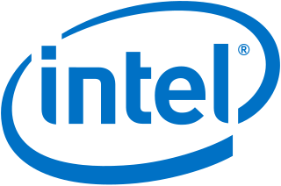
3. Security Framework of Intel SGX
Crypto Guarantees and Primitives
SGX Functionalities
SGX Enclave Lifecycle
Notes:
There are certain information that are essential to start developing secure enclave based applications. Understanding what and how crypto guarantees are implemented
with SGX is the ﬁrst step towards developing secure enclave applications. It is also imperative to understand the lifecycle and memory management of enclaves to get a clearer view of how memory leaks or insecure pointer handling can result in the failure of crypto guarantees.

Slide 17
Crypto Guarantees and Primitives
Software Systems rely on cryptographic primitives for security but these primitives have many assumptions.
Building a secure system on top of them is not always feasible.
Zero-knowledge proof provides a way for one entity to prove that it knows a secret without revealing anything else. Intel EPID uses Direct Anonymous Attestation (DAA) crypto primitive.
EPID is a group signature scheme that is intended to preserve the anonymity of the signers
Guarantee | Primitive
Conﬁdentiality | Encryption
Integrity | MAC / Signatures
Freshness | Nonce + integrity
3. Security Framework of Intel SGX
Notes:
vast majority of software attacks exploit a bug in a software component, there are a few attack classes that deserve attention from architecture designers
Zero-knowledge proofs acknowledge that it is diﬃcult to demonstrate that one possesses knowledge of certain information without simply revealing the information and allows the entity to prove possession without revealing the information itself.

Slide 18
2. SGX Functionalities
Memory Design
Enclaves reside in Random Access Memory(RAM), called the Processor Reserved Memory (PRM).
PRM is protected from non-enclave processes and memory access.
The PRM holds the Enclave Page Cache(EPC), which encompasses 4 KB pages that store both the code and data.
Only the EPC Metadata is disclosed to the software once the enclaves are initialized.
Each EPC page belongs to exactly one enclave.
The enclave contents are then hashed by the CPU, called the measurement hash, which is used by attestation services.
Data Sealing
Software Attestation
3. Security Framework of Intel SGX

Slide 19
2.2 SGX Functionalities - Data Sealing
Bind data to a specific TEE and TCB.
Need data to persist as enclave memory is restricted in size.
Seal to Enclave
Hashing of the enclave memory - Measurement hash calculation
Binds to the encryption key using EGETKEY instruction.
Seal to Author
Retrieve enclave author’s signature (stored in the MRSIGNER register)
Binds to the encryption key using EGETKEY instruction.
Which one is better?
Update enclave by the enclave author without serious upgrade process or recalculating measurement hash.
Bind a Security Version Number (SVN) too.
Data is sealed using AES-GCM
API
1. sgx_seal() / sgx_unseal
2. sgx_rijndael128GCM_encrypt / sgx_rijndael128GCM_decrypt
3. Security Framework of Intel SGX
Notes:
SVN - option to unseal data that has been sealed by an earlier version of the enclave. This feature can mainly be used for software updates.

Slide 20
2.3 SGX Functionalities - Software Attestation
Why? Prove that a software is running on a secure and authenticated platform.
Local Attestation :
Different enclaves inside the same computer need to cooperate with one another to perform some higher-level function.
Both enclaves create a credential, also known as a report. This report contains a cryptographic proof that the enclave is in the specified platform
Report consists of Measurement of the code and data in the enclave + Hash of the public key in the ISV certificate + AAD + A platform verifiable signature of the above data.
Remote Attestation :
User is communicating with a secure enclave hosted on different trusted hardwares.
An attestation signature, called a quote, is produced by the hardware’s secret attestation key and is presented as proof to the user.
This quote is verified using Intel(R) EPID signature verification.
A quote has everything that a report has. But the signature is verified by Intel EPID.
3. Security Framework of Intel SGX
Notes:
Remote attestation - the CPU key is not directly exposed outside the platform

Slide 21
3. SGX Enclave Life Cycle and APIs
Creation
ECREATE instruction creates a new enclave by turning a free EPC page into a SGX Enclave Control Structure(SECS)
Here the enclave size is also declared(n^2).
Loading
Code is loaded into the enclave,
EADD instruction to load the initial code and data into the secure enclave.
Initialization
A Launch Enclave (LE) is launched to obtain a EINIT token structure.
Also the LE is cryptographically signed with a key that is hard-coded into the hardware.
INIT attribute in the SECS to true - EADD cannot be called anymore.
Tear Down
EREMOVE instruction deallocates the EPC pages used by the enclave.
The SECS memory is freed from the EPC
All these processes are abstracted by the SGX API
3. Security Framework of Intel SGX

Slide 22
4. Methods and Implementation
Use-case Solutions
Process Outline
Cancer Diagnostics
Software design

Slide 23
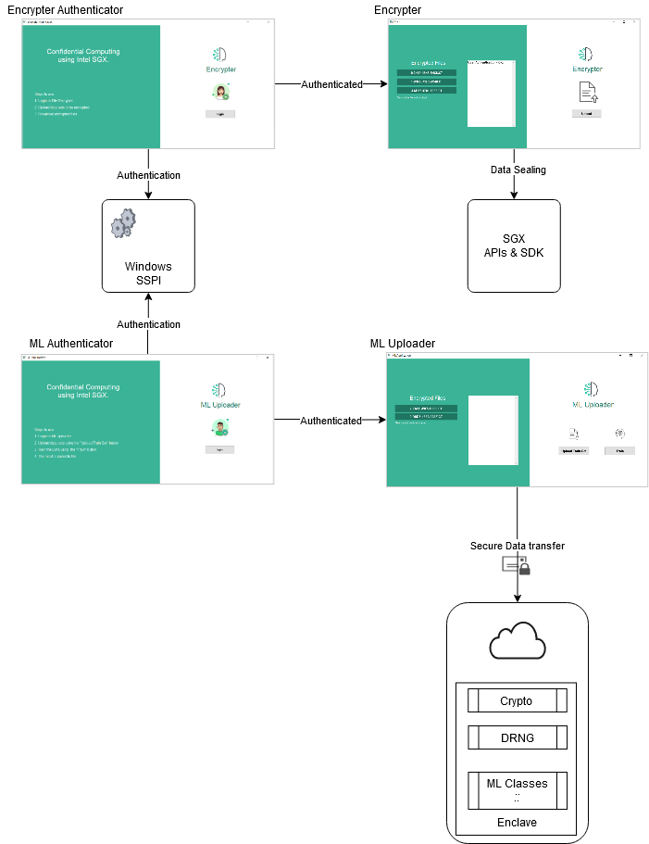
4.3. Process Outline
Two main code bases:
Trusted code base - Enclave itself
Untrusted code base - Rest of the application
Process:
User Authentication - Login
Data Encryption
Data Upload
Remote Learning
Download results
Application Requirements:
Intel SGX capable systems or Visual Studio 2017 with Intel SGX SDK
Windows 10 64-bit for Intel SGX support
Intel processor that supports Intel Data Protection Technology(DPT) with Secure Key
4. Methods and Implementation

Slide 24
4.1. Use-case Solution
Medical Use-case
A pharmaceutical company has a machine learning model that can predict the occurrence of a disease to a certain extent.
Participating clinics are very cautious with patient data - Confidential and Sensitive.
Clinics do not possess the required hardware nor the knowledge to train the model locally.
Solution:
Enclave application.
Encrypt data locally and then send it over to the secure machine learning platform.
The results are encrypted and sent to all participating parties.
Success?
No plaintext patient data ever leaves the clinics’ jurisdictions.
Secure link and trust throughout the community and train their model on all the combined data without actually having access to all of it.
4. Methods and Implementation
Notes:
The company can then use this result to change production of medicines, Personal Protective Equipment (PPE), vaccines, etc

Slide 25
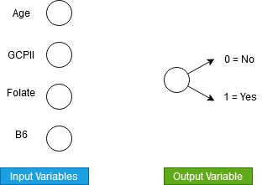
4.2. Cancer Diagnostics Use case
Introduction
The etiology of breast cancer involves several physiological, genetic, dietary factors.
Even before a person develops cancer, a machine learning based prediction model may provide insights into their susceptibility to the disease.
Physiological
Genetic
Dietary
4. Methods and Implementation
Notes:
75% train data + 25% test data.

Slide 26
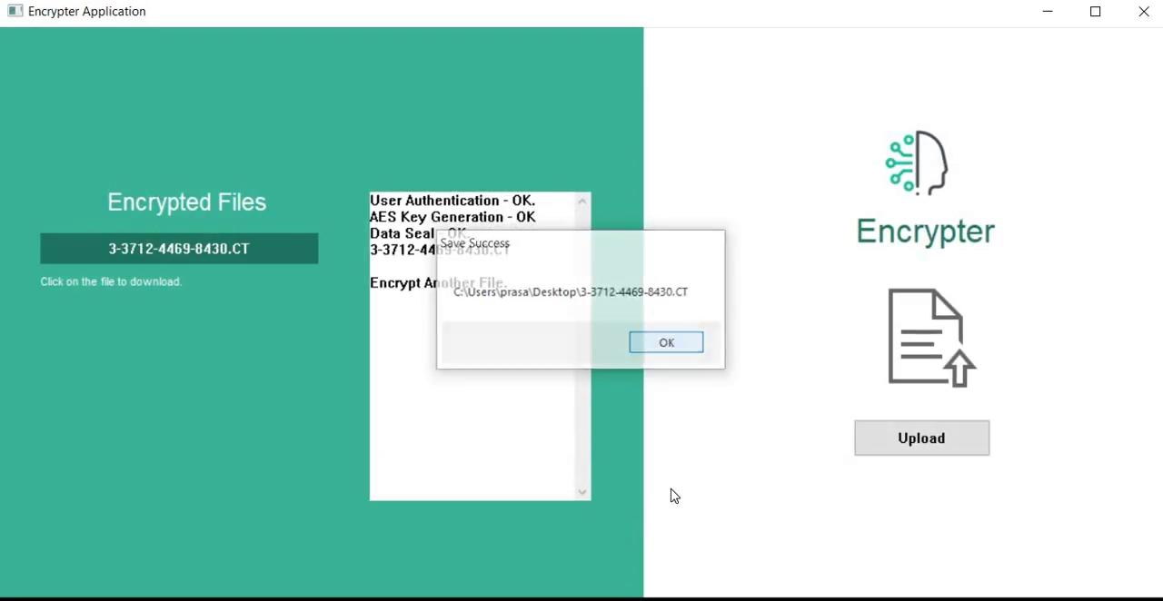
4.2. Cancer Diagnostics Use case
Hospital A Encrypts their data set.

Slide 27
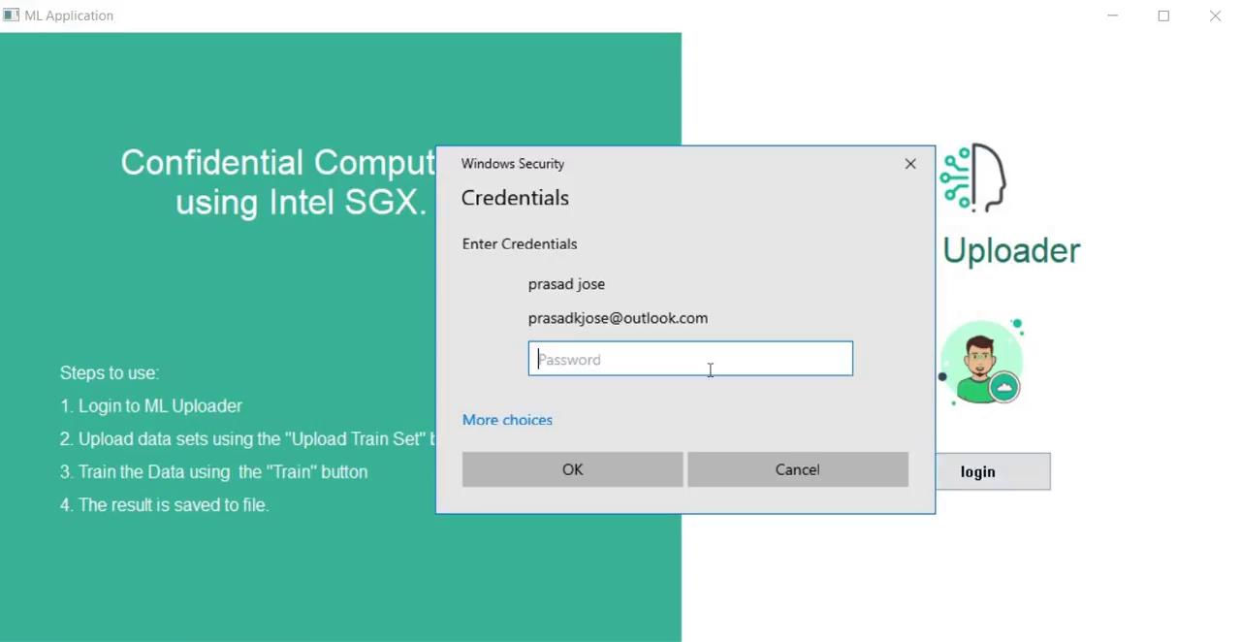
4.2. Cancer Diagnostics Use case
Training with just 1 hospital as a participant.
Test Accuracy : 83.3%

Slide 28

4.2. Cancer Diagnostics Use case
Hospital B Encrypts their data set.

Slide 29
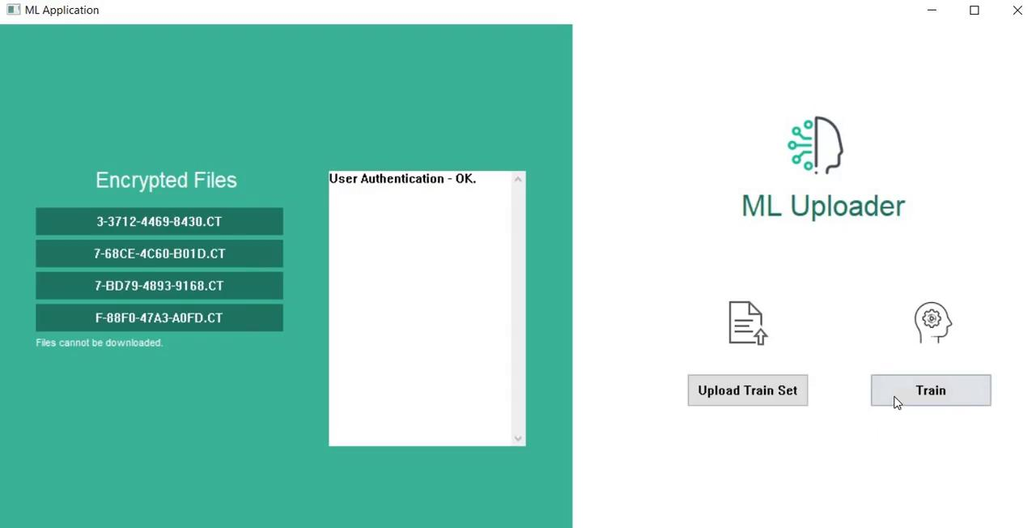
4.2. Cancer Diagnostics Use case
Training with just 2 participating hospitals.
Test Accuracy : 95%

Slide 30
4.2. Cancer Diagnostics Use case
Results :
Accuracy increases with the number of participating clinics and their data sets.
Patient data is secure and tamper resistant.
Different Hospitals or clinics do not have access to the plaintext data uploaded by the other participants.
Accuracy of up to 95% with all the sample data sets.
4. Methods and Implementation

Slide 31
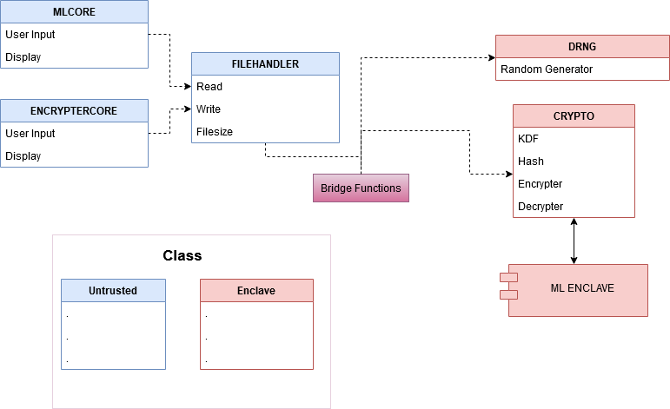
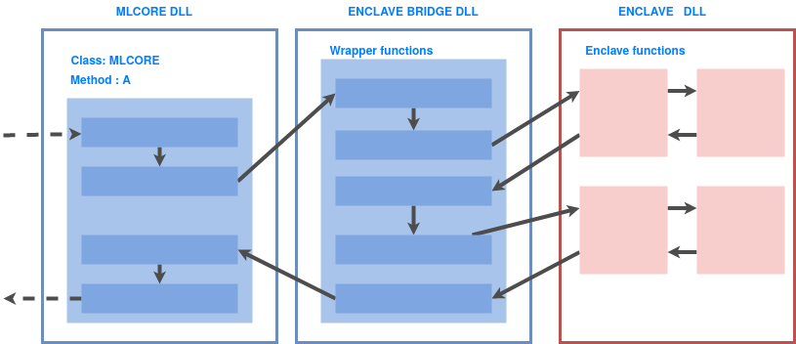
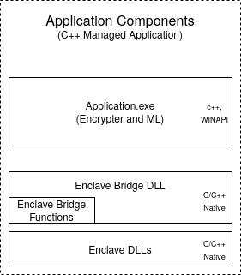
4.4. Software design
4. Methods and Implementation

Slide 32
5. Security Considerations
Threat Model
Attack surfaces

Slide 33
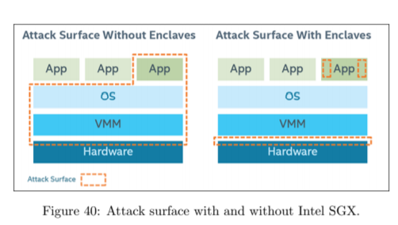
5. Threat Model and Attack Surface
Standard SGX threat model .
The adversary
is in complete control of privileged software.
can also read and write to any memory region except the enclave memory.
has control of the cloud and any communication from the participating users and the cloud.
5. Security Considerations

Slide 34
Security Analysis of the Application
Enclave memory cannot be modified from outside the enclave.
Production enclaves are more secure then debug enclaves.
Only protected calls like ECalls and OCalls can communicate with the enclave.
Sealing is done using industry standard protocols.
The main encryption key is randomly changed between every power cycle.
Bugs in the software can be exploited by adversaries.
If the enclave is developed with an infected OS, then the enclave can be compromised too.
Third-party libraries should be used carefully - Potential vulnerability.
CPU bugs in the hardware logic or in the microcode, can be used to attack the enclave.
5. Security Considerations
Notes:
3. classic function calls, jumps, register manipulations or stack manipulations will not work in an enclave. The only way to call enclave functions is through a new instruction which performs several protection checks
4.

Slide 35
The need for secure data and data computation is the primary motivation of this thesis.
This work proposed a conﬁdential computing system using Intel SGX as a trusted environment and to study the practical implications of such a system.
The work explored the design aspects of the system and also studied the security considerations of each of the components.
Intel SGX is vulnerable to attacks.
Enclave applications on SGX are deﬁnitely safer than traditional applications because Intel has earned this trust.
Responsible software design and development is key for minimizing risks of system penetration and unauthorised access.
6. Conclusion & Future Works
6. Conclusion and Future Works

Slide 36

Many works are in progress with respect to confidential computing.
Intel promises to release regular updates with the SDK.
Many container based implementations are also being developed by third party researchers but no Intel support.
Increase the popularity of Intel SGX is to enable enclave programming in other major programming languages like Rust, Python, Swift etc
Increase the computational performance of an enclave by securely leveraging the GPU by creating a secure environment on GPUs.
Increasing the EPCs are a good way to write larger applications which is important in many real-life use cases.
6. Conclusion & Future Works
Alert
Google Launches confidential VMs in Beta on Its Cloud Platform - July 15th 2020
Link : https://cloud.google.com/blog/products/identity-security/introducing-google-cloud-confidential-computing-with-confidential-vms
6. Conclusion and Future Works
Notes:
need to incorporate inputs from multiple data owners like (Amazon, Facebook, Google etc) for a single machine learning problem like product recommendation

Slide 37
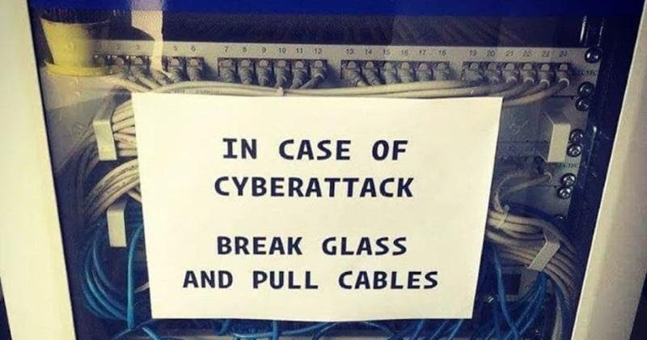
THE END

Slide 38
Attributions
Icons made by <a href="https://www.flaticon.com/authors/freepik" title="Freepik">Freepik</a> from <a href="https://www.flaticon.com/" title="Flaticon"> www.flaticon.com</a>
https://commons.wikimedia.org/wiki/File:Artificial_neural_network.svg

